Slide 1


AME 20216 Lab I
www.nd.edu/~prumbach/AME20216
Paul Rumbach
prumbach@nd.edu
363 Fitzpatrick Hall
John Ott
jott@nd.edu
B14 Fitzpatrick Hall
Labs begin next week in B14 Fitzpatrick!

Slide 2
Labs Begin Feb. 9th in B14 Fitzpatrick

Slide 3

Official Lab Notebook
(Required)
For sale in the Hammes bookstore

Slide 4

Measurement and Data Analysis for Engineering and Science by Patrick F. Dunn, 4th edition
2nd and 3rd edition is OK, but page numbers will be different!

Slide 6
Weekly to-do
Videos and pre-lab quiz posted Fridays.
Pre-lab Quiz (Sakai) due Sundays at midnight.
Go to lab on weekday, get data.
Write tech memo. Upload PDF to Sakai by Thursday at midnight.

Slide 7
Office Hours: Mon. & Weds. 2 – 3pm via Zoom

Slide 8
COVID-19 Protocols
Wash hands upon entering the lab.
Put on nitrile gloves after washing hands.
Sanitize lab bench and equipment with alcohol wipes after performing the lab.
Wear a mask at all times during lab.

Slide 9

Be safe. Be cool. Obey the COVID rules.

Slide 10

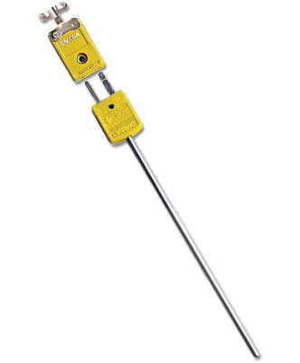
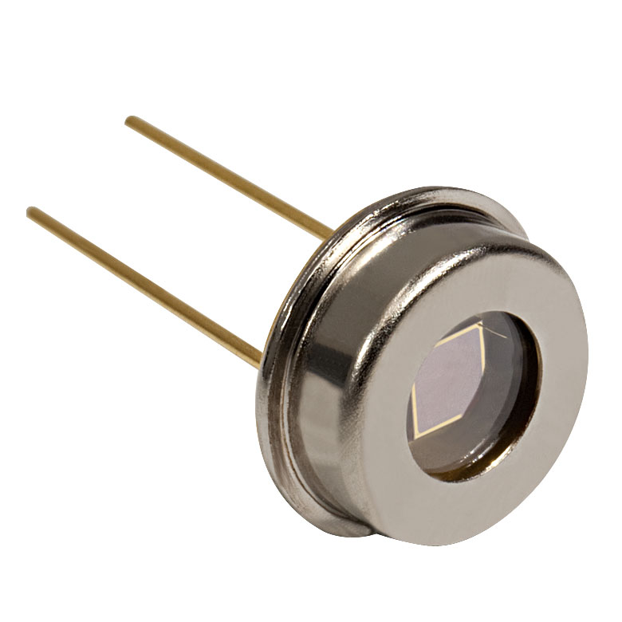

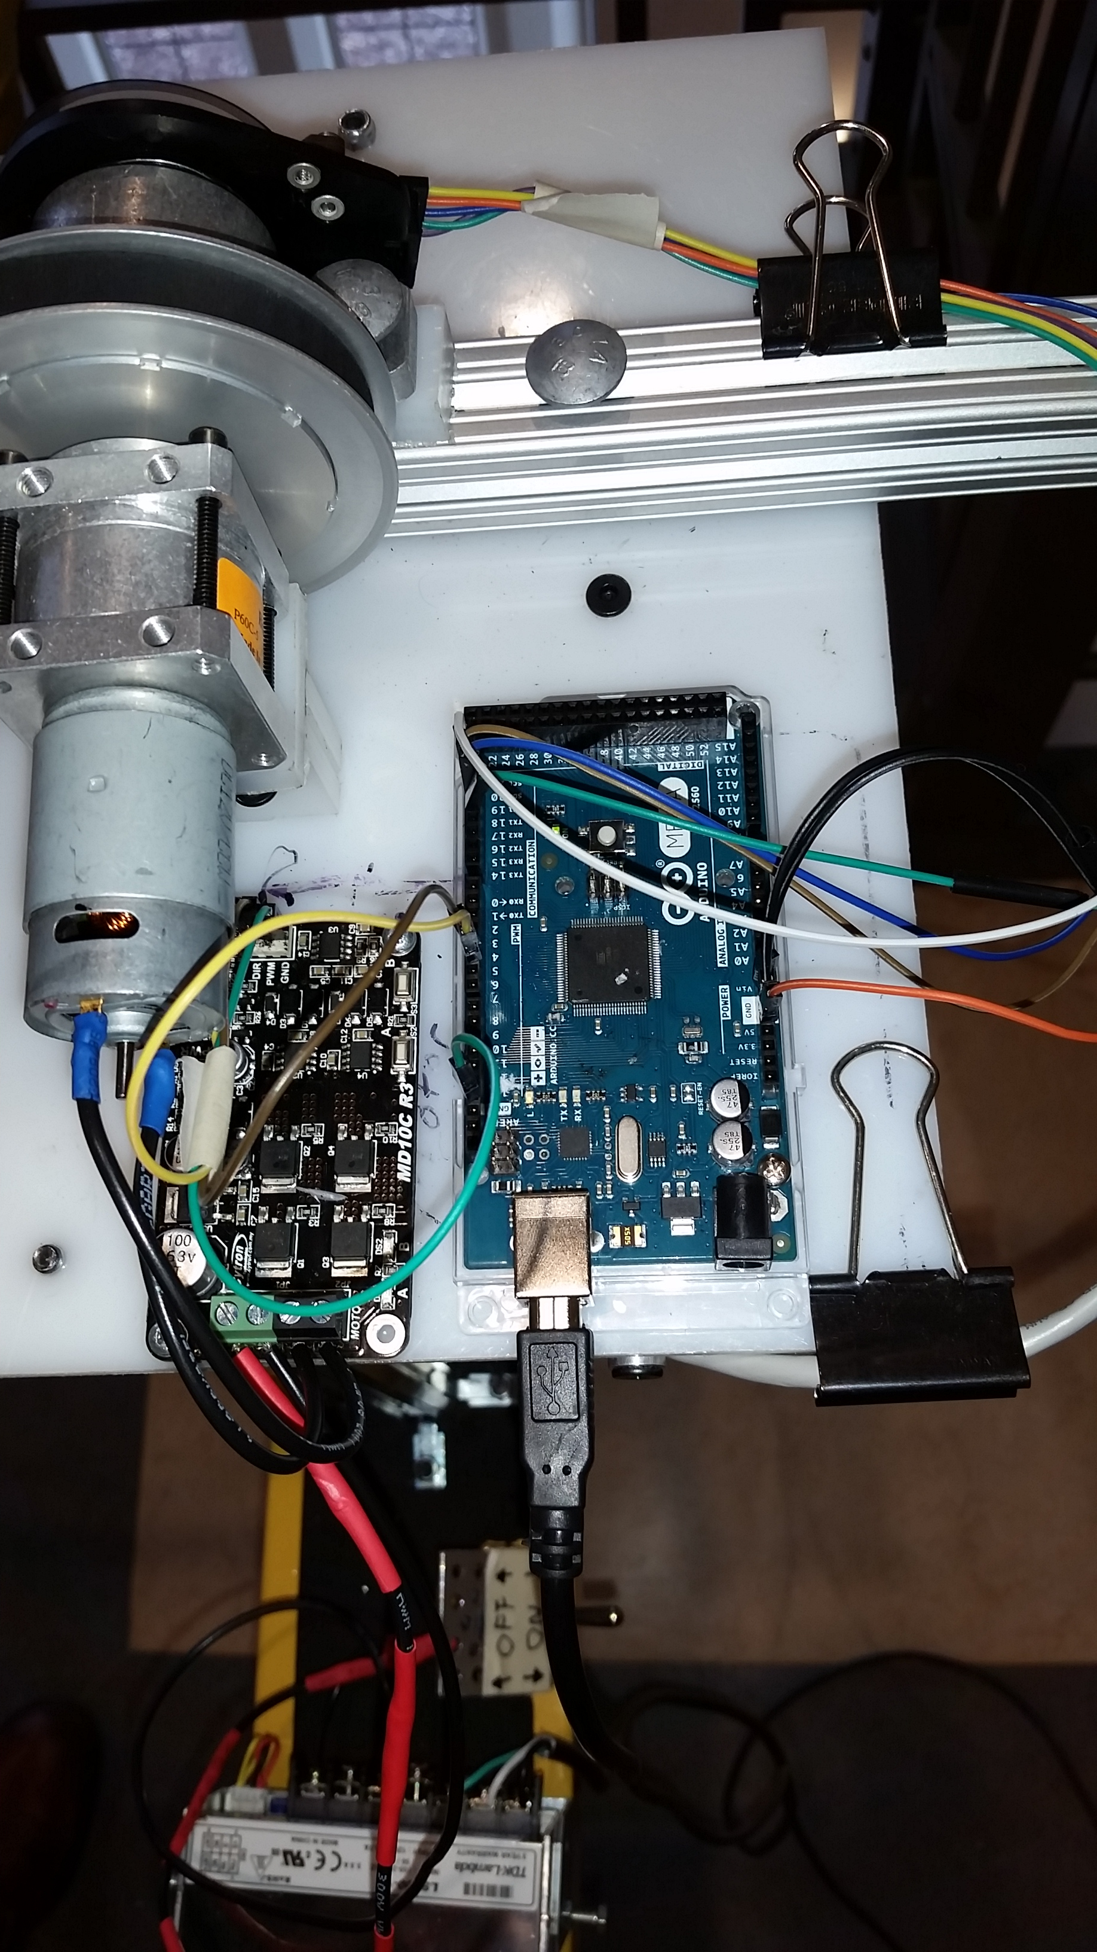
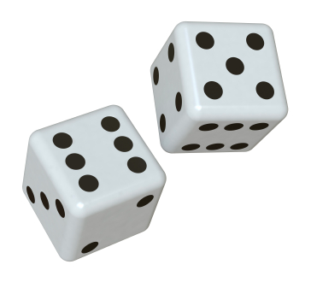
Three Pillars of AME20216
MOST DIFFICULT
Sensors and Electronics
Data Analysis
Technical Writing

Slide 11
Effective Communication

Slide 12
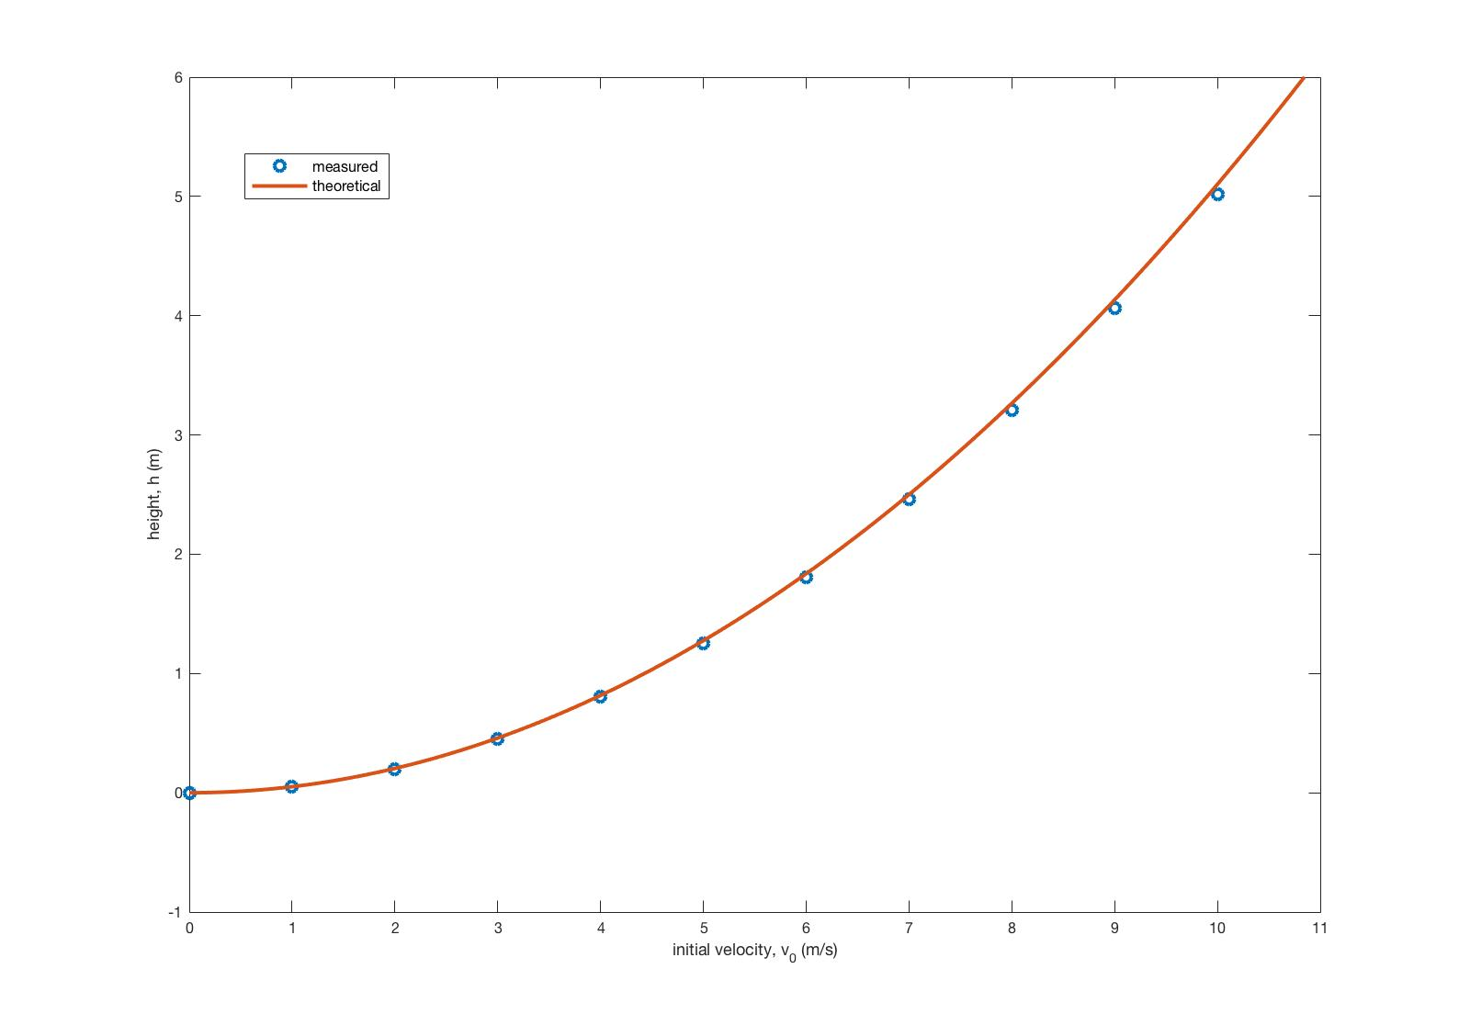
Effective Communication

Slide 13
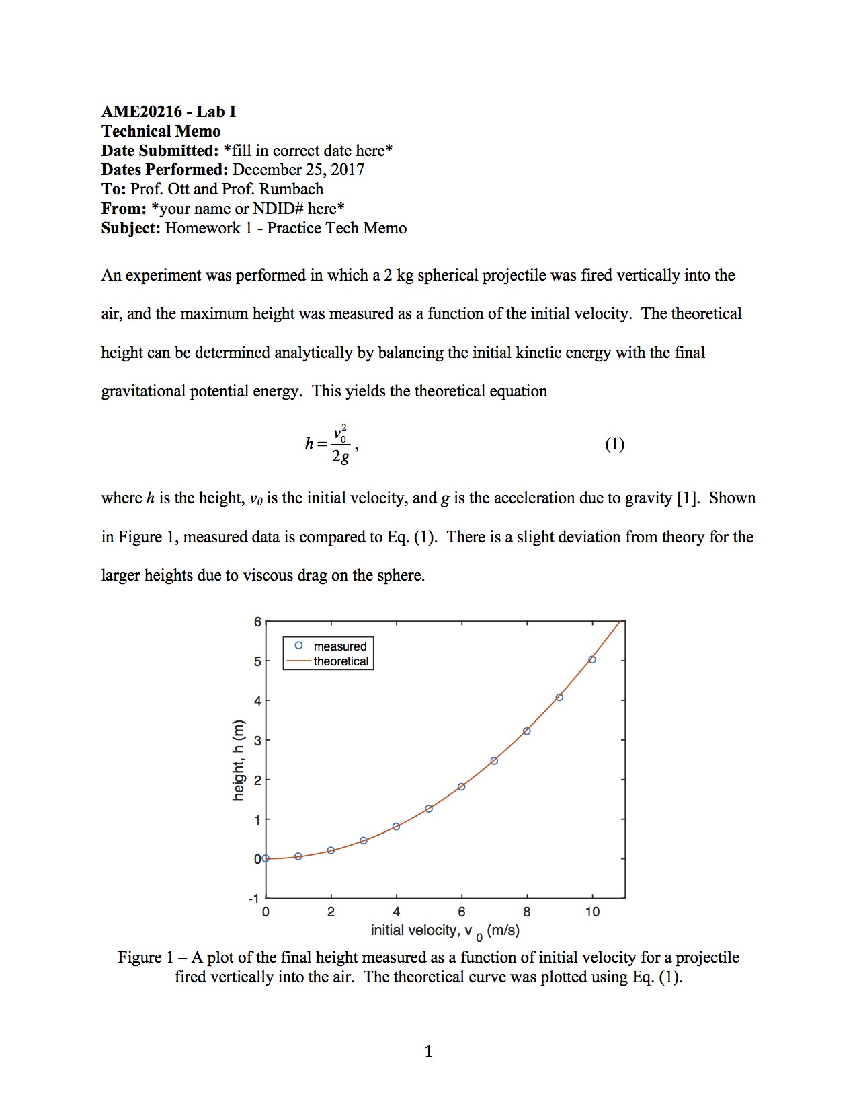
Homework 1

Slide 14

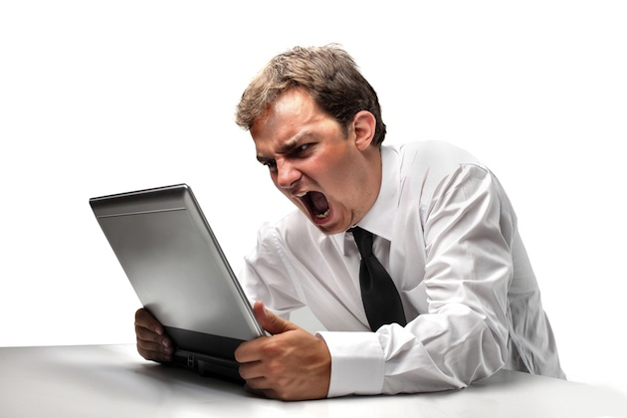
Feedback from Graders
“This is BOGUS! The graders need to change their ways!”
“Ok, I will not make that mistake again.”
Sub-standard work.
Lackluster career.
Quality work.
Successful career!

Slide 15

See you in lab next week!

